Slide 1
Executive Summary
Analysis of Product Performance, Supplier Efficiency, and Customer Feedback

Slide 2
Product Performance
The analysis identified the most and least popular product types based on total sales.
The bar chart on the next slide illustrates the distribution of sales across different product types.

Slide 3
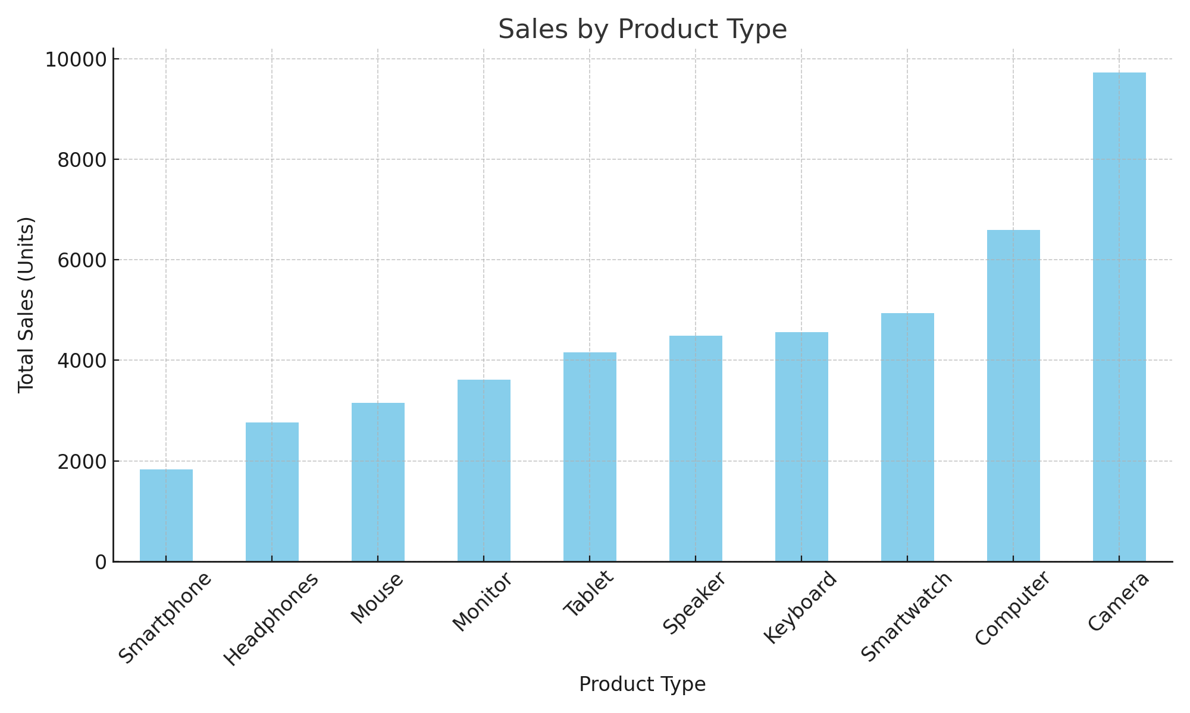
Sales by Product Type

Slide 4
Supplier Efficiency
The top 5 suppliers were identified based on their contribution to sales and customer satisfaction.
The combined bar and line chart on the next slide shows the total sales and average rating for these top suppliers.

Slide 5
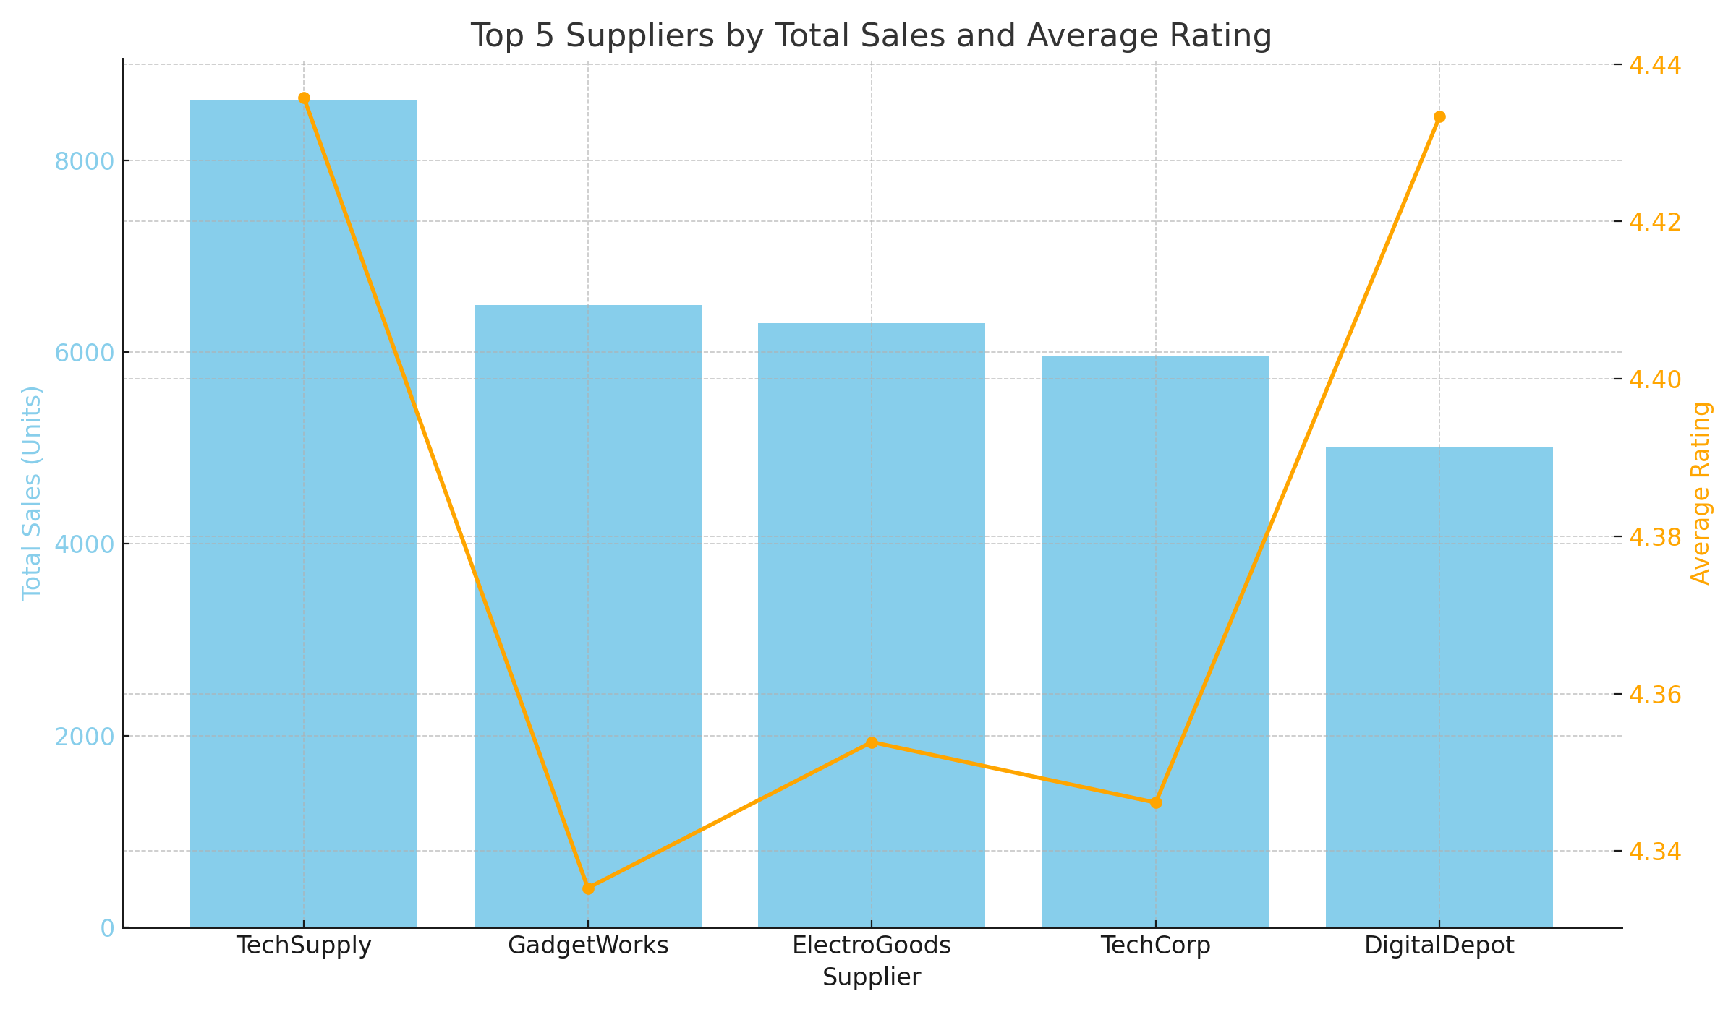
Top 5 Suppliers by Total Sales and Average Rating

Slide 6
Customer Feedback
The analysis of customer feedback identified the products with the lowest ratings.
The horizontal bar chart on the next slide highlights these products and their respective ratings.
Further investigation into these products suggests potential quality issues or mismatch between price and perceived value.

Slide 7
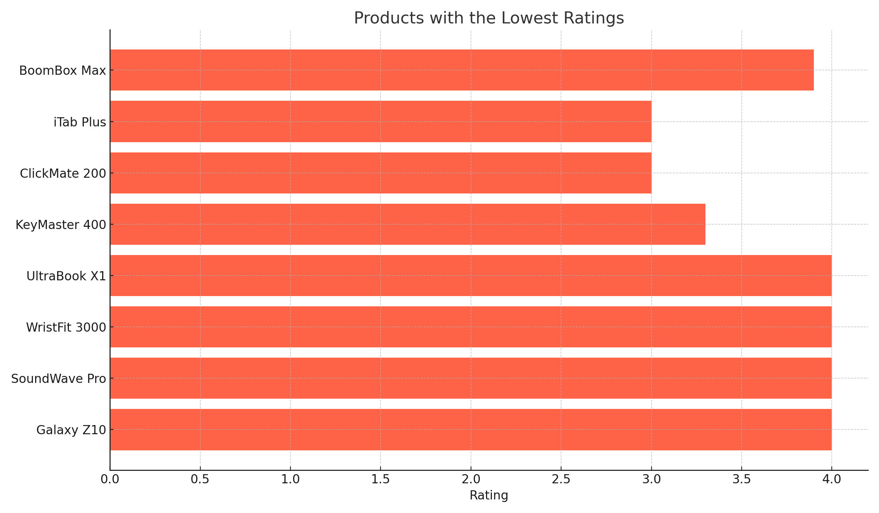
Products with the Lowest Ratings

Slide 8
Actionable Recommendations
Based on the analysis, here are some actionable recommendations:
- Focus on improving or discontinuing the lowest-rated products. Conduct surveys or gather customer feedback to understand specific issues.
- Invest in R&D for popular product types to maintain market leadership and introduce new features that meet customer demands.
2. **Strengthen Supplier Relationships**:
- Maintain strong relationships with top-performing suppliers like TechSupply and GadgetWorks.
- Explore opportunities to negotiate better terms or expand product lines with these suppliers.
- Regularly evaluate supplier performance to ensure consistent quality and delivery.
3. **Improve Customer Satisfaction**:
- Address the issues with the lowest-rated products. Quality improvements and better customer support can help enhance ratings.
- Implement a robust feedback mechanism to continually gather and act on customer insights.
- Consider loyalty programs or incentives for high-rated products to boost customer satisfaction and retention.

Slide 9
Actionable Recommendations - Product Performance
1. Enhance marketing efforts for the least popular product types to increase visibility and sales.
2. Review pricing strategy for the least popular products to ensure they offer competitive value.
3. Introduce new features or improvements to the least popular products based on customer feedback.

Slide 10
Actionable Recommendations - Supplier Efficiency
1. Strengthen relationships with the top 5 suppliers by negotiating better terms and ensuring timely deliveries.
2. Monitor supplier performance regularly to maintain high standards of product quality and customer satisfaction.
3. Diversify supplier base to reduce dependency on a few suppliers and mitigate risks.

